Slide 1


Introduction to Bayesian Estimation
STA 4030A - Bayesian Inference and Decision theory

Slide 2
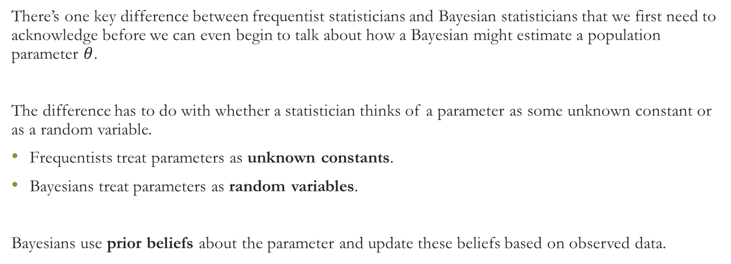
Bayesian vs Frequentist Statisticians
There’s one key difference between frequentist statisticians and Bayesian statisticians that we first need to acknowledge before we can even begin to talk about how a Bayesian might estimate a population parameter $θ$.
The difference has to do with whether a statistician thinks of a parameter as some unknown constant or as a random variable.
Frequentists treat parameters as unknown constants.
Bayesians treat parameters as random variables.
Bayesians use prior beliefs about the parameter and update these beliefs based on observed data.

Slide 3

Example: Intersection Traffic Problem
A traffic engineer believes cars pass through an intersection at a mean rate $λ=3$ or $λ=5$ per time interval. Initially, the engineer assigns prior probabilities:
$$P\left(λ=3\right)=0.7 \text{and} P\left(λ=5\right)=0.3$$
After observing 7 cars passing through during an interval, we calculate the updated probabilities (posterior probabilities) using Bayes’ Theorem.

Slide 4

Bayes’ Theorem
To compute the posterior probability that $λ=3$ given the observed data:
$$P\left(λ=3∣X=7\right)=\frac{P\left(X=7∣λ=3\right)P\left(λ=3\right)}{P\left(X=7\right)}$$
Where $P\left(X=7∣λ=3\right)$ and $P\left(X=7∣λ=5\right)$ are obtained from the Poisson distribution.

Slide 5

Calculating Posterior Probabilities
Using the Poisson distribution table, we find:
$$P\left(X=7∣λ=3\right)=0.988−0.966=0.022$$
$$P\left(X=7∣λ=5\right)=0.867−0.762=0.105$$
We can now compute the posterior probabilities:
$$P\left(λ=3∣X=7\right)=\frac{\left(0.7×0.022\right)}{\left(0.7×0.022\right)+\left(0.3×0.105\right)}=\frac{0.0154}{0.0154+0.0315}=0.328$$
$$P\left(λ=5∣X=7\right)\frac{\left(0.3×0.105\right)}{\left(0.7×0.022\right)+\left(0.3×0.105\right)}=\frac{0.0315}{0.0154+0.0315}=0.672$$

Slide 6
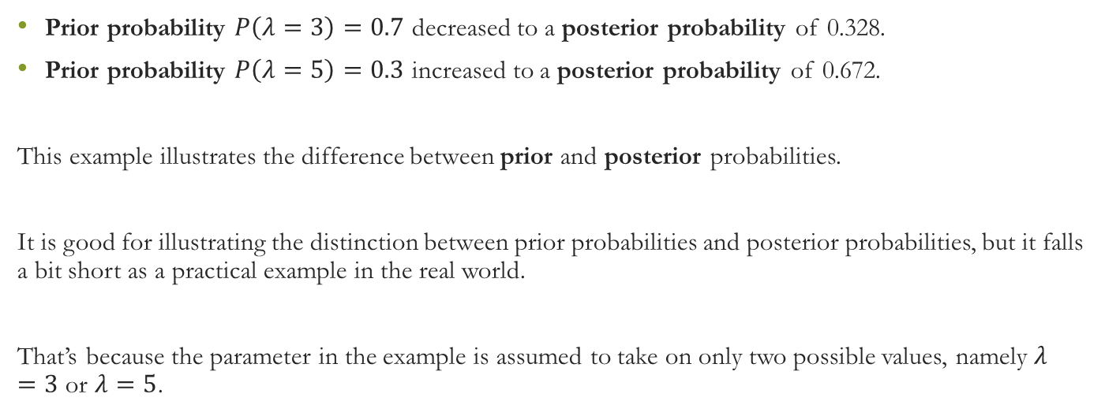
Prior vs Posterior
Prior probability $P\left(λ=3\right)=0.7$ decreased to a posterior probability of 0.328.
Prior probability $P\left(λ=5\right)=0.3$ increased to a posterior probability of 0.672.
This example illustrates the difference between prior and posterior probabilities.
It is good for illustrating the distinction between prior probabilities and posterior probabilities, but it falls a bit short as a practical example in the real world.
That’s because the parameter in the example is assumed to take on only two possible values, namely $λ=3$ or $λ=5$.

Slide 7
Example: Disease and Test
Credit: The following example was inspired by Judea Pearl’s The Book of Why.
Problem Setup
We want to estimate the probability of having a disease (D) given the result of a test (T).
Prior Probabilities:
P(D = 1) = 0.1 (10% of the population has the disease)
P(D = 0) = 0.9 (90% of the population is healthy)
D can take two values: - 0: Healthy - 1: Sick

Slide 8
Example: Disease and Test
Likelihood
From historical data, we know how reliable the test is:
P(T = 1 | D = 1) = 0.75 (75% chance the test is positive if the patient has the disease)
P(T = 0 | D = 1) = 0.25 (25% chance the test is negative if the patient has the disease)
P(T = 1 | D = 0) = 0.2 (20% chance the test is positive if the patient does NOT have the disease)
P(T = 0 | D = 0) = 0.8 (80% chance the test is negative if the patient does NOT have the disease)
Each value of D has a corresponding conditional probability distribution over T.

Slide 9
Example: Disease and Test
The Inverse Problem
We are interested in the reverse conditional probability:
P(D = 1 | T = 1): The probability of having the disease given a positive test result.
This is where Bayes’ Rule comes into play.

Slide 10
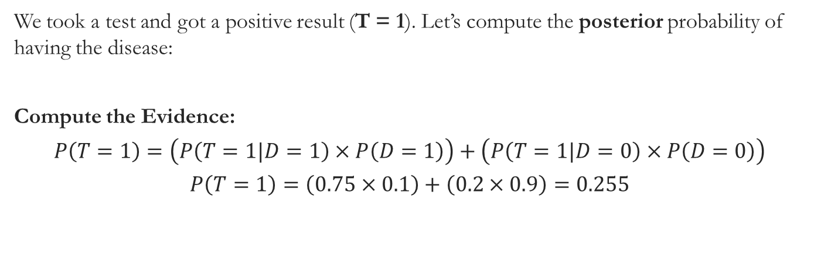
Bayes’ Rule in Action
We took a test and got a positive result (T = 1). Let’s compute the posterior probability of having the disease:
Compute the Evidence:
$$P\left(T=1\right)=\left(P\left(T=1|D=1\right)×P\left(D=1\right)\right)+\left(P\left(T=1|D=0\right)×P\left(D=0\right)\right)$$
$$P\left(T=1\right)=\left(0.75×0.1\right)+\left(0.2×0.9\right)=0.255$$

Slide 11
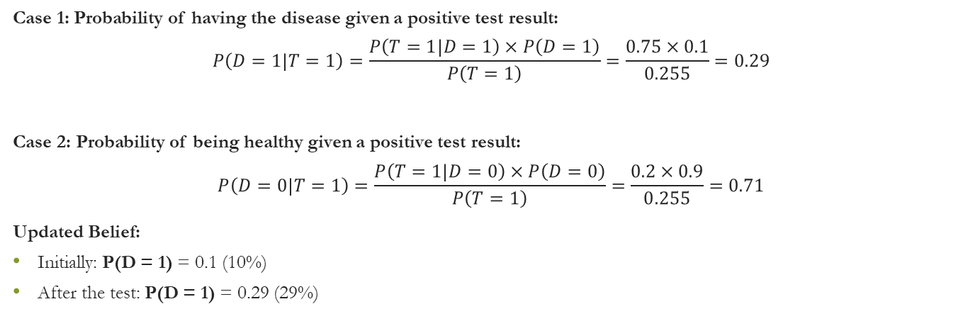
Posterior Distribution
Case 1: Probability of having the disease given a positive test result:
$$P\left(D=1|T=1\right)=\frac{P\left(T=1|D=1\right)×P\left(D=1\right)}{P\left(T=1\right)}=\frac{0.75×0.1}{0.255}=0.29$$
Case 2: Probability of being healthy given a positive test result:
$$P\left(D=0|T=1\right)=\frac{P\left(T=1|D=0\right)×P\left(D=0\right)}{P\left(T=1\right)}=\frac{0.2×0.9}{0.255}=0.71$$
Updated Belief:
Initially: P(D = 1) = 0.1 (10%)
After the test: P(D = 1) = 0.29 (29%)

Slide 12

Bayesian Updating with a Second Test
Let’s assume we take a second test, and it also comes back positive (T = 1). We can use the updated distribution as the new prior and repeat the calculation.
Compute the new Evidence:
$$P\left(T=1\right)=\left(0.75×0.29\right)+\left(0.2×0.71\right)=0.36$$
Compute the Updated Posterior:
$$P\left(D=1|T=1\right)=\frac{P\left(T=1|D=1\right)×P\left(D=1\right)}{P\left(T=1\right)}=\frac{0.75×0.29}{0.36}=0.6$$
After two positive tests: - P(D = 1) = 0.6 (60%)

Slide 13
Likelihood Ratio
The likelihood ratio is the ratio of the likelihood to the evidence. It shows how much the prior belief is increased or decreased based on the test result.

Slide 14
Conclusion
We updated our belief about having the disease using Bayes’ Rule.
After a single positive test, the probability of having the disease increased from 10% to 29%.
After a second positive test, it further increased to 60%.
Bayesian updating allows for the continuous refinement of beliefs as new evidence is incorporated.

